Slide 1
Model-based Integrated Planning and Control of Autonomous Vehicles using Artificial Potential Fields with uncertain environment
Emilio Benenati
Josyula Viswanath Das
17th September 2021

Slide 2
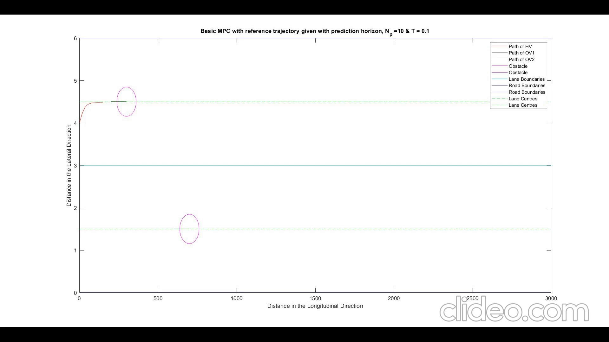
Moving MPC with the vel_{HV}> vel_{OV}

Slide 3
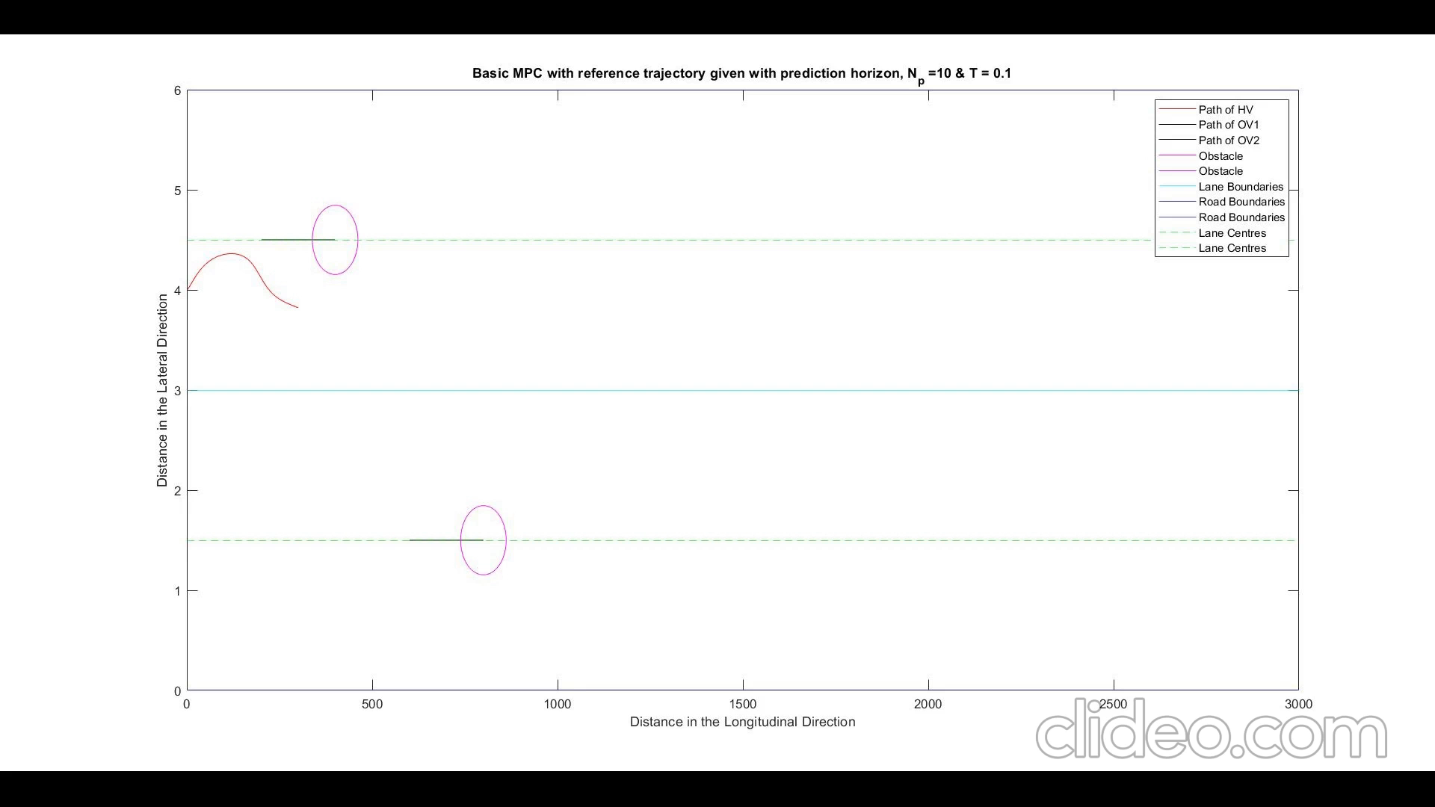
Moving MPC with the vel_{HV}> vel_{OV} and the height of the potential field on the lane boundary is reduced.

Slide 4
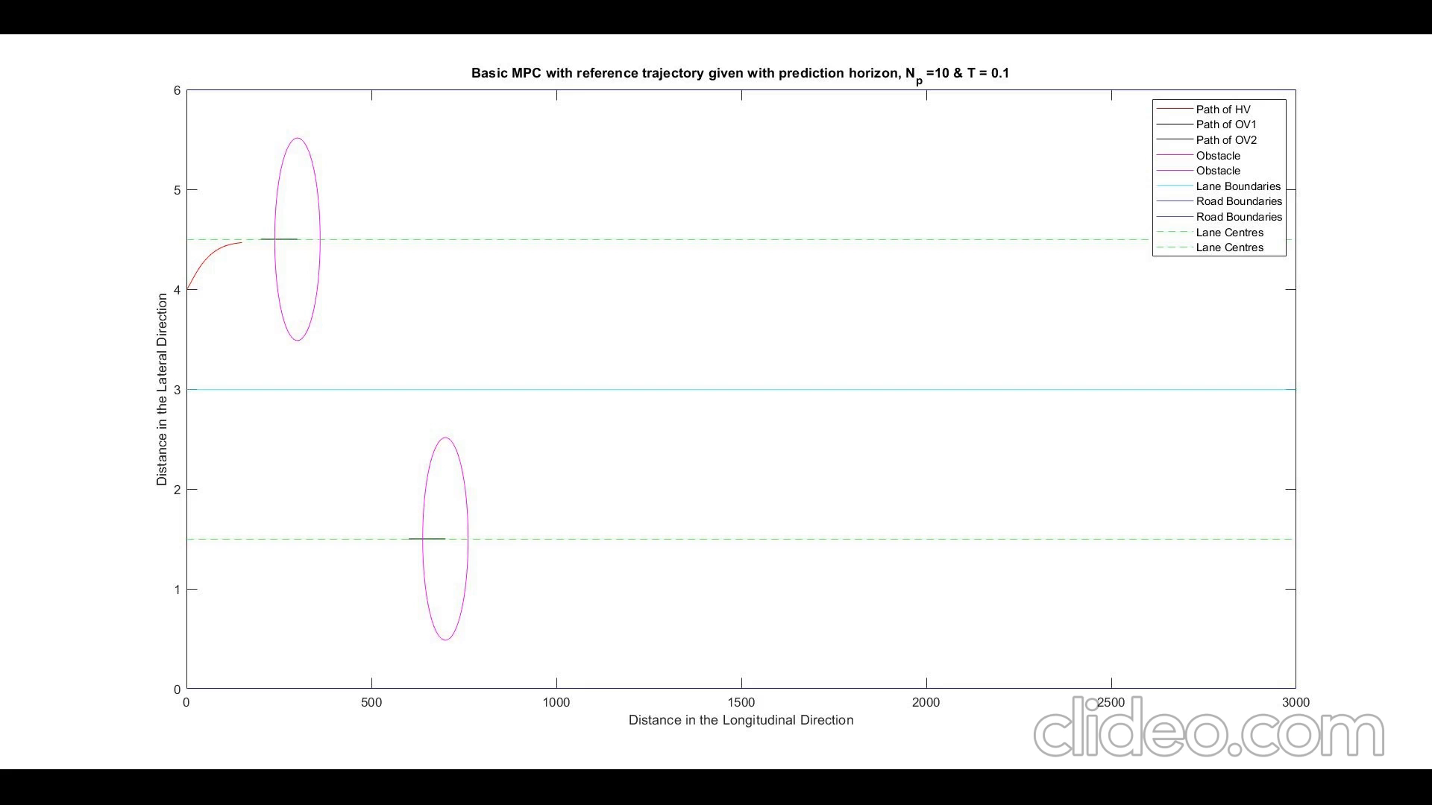
Moving MPC with the vel_{HV}> vel_{OV} ,the height of the potential field on the lane boundary is reduced and the size of the vehicle potential field is increased

Slide 5
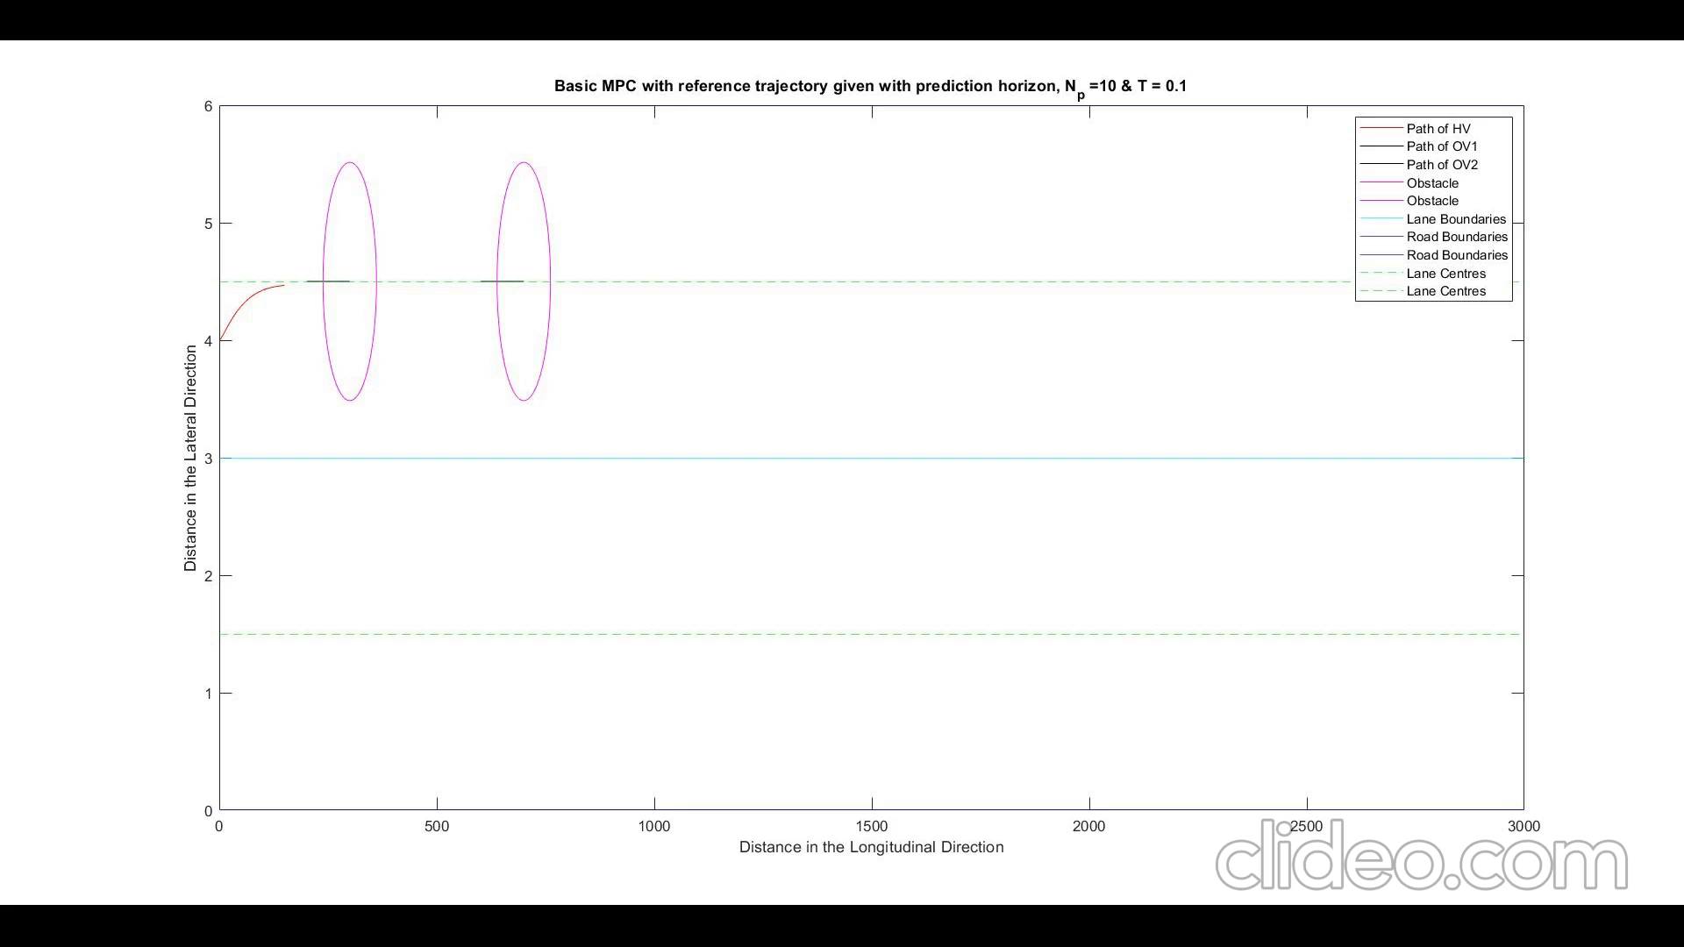
Moving MPC with the vel_{HV}> vel_{OV} ,the height of the potential field on the lane boundary is reduced and the size of the vehicle potential field is increased and both obstacles on the same lane

Slide 6
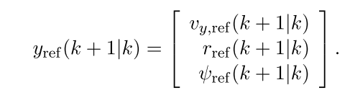
Fig: Old Measured Values of the System
y_{ref}(k+1|k)
Fig: New Measured Values of the System

Slide 7

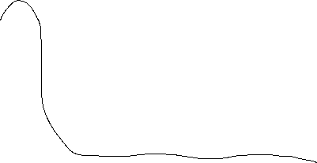
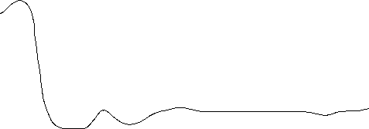
Moving MPC with the vel_{HV}> vel_{OV} with changes as above but a reference trajectory for y position is added

